Slide 1
FILTRATION
PART I.

Slide 2
1 Definition
Filtration is a process of separating dispersed particles from a dispersing fluid by means of porous media. The dispersing medium can be a gas (or gas mixture) or a liquid.
Upstream
Face of the filter with „filter cake“ of deposited particles
Downstream
Particles deposited inside the filter
Filter
Dispersing fluid
Dispersed particles
Filter thickness
Channel wall

Slide 3
2 Types of filtration
Concerning to filtration surrouding:
Air filtration / Liquid filtration
Concerning to size of filtered particles:
Macrofiltration for particle size dp: 10⁻⁶ m < dp
Microfiltration 10⁻⁷ < dp < 10⁻⁶
Ultrafiltration 10⁻⁸ < dp < 10⁻⁷
Nanofiltration 10⁻⁹ < dp < 10⁻⁸
Reverse osmosis dp < 10⁻⁹
Concerning to filtration mechanism:
Surface filtration / Depth filtration

Slide 4
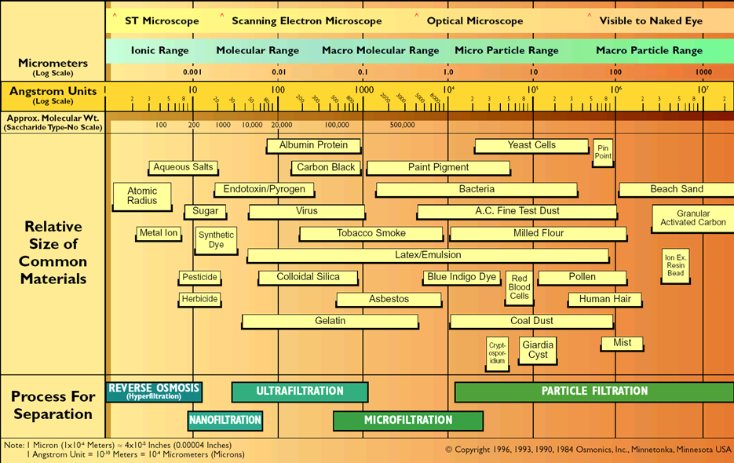
2.1 Relative size of common filtered particles

Slide 5
2.2 List of airborne pollutants and the American Industrial Hygiene Association, 1993, approved safe levels

Slide 6
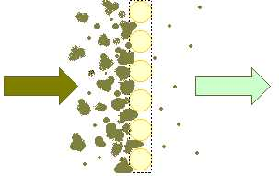
2.3 Surface filtration
All particles which are bigger than pores are captured on the flat filter surface and create „filter cake“. It is typical for example for woven fabric or spunbond filters. Thus for these filters the pores distribution and permeability are important properties. Flat filtration is more common for liquid filtration.
Advantage:
It is very important for the cleanable filters – filter cake is possible to release from the filter surface.
It is possible to capture all particles, which are bigger than pore size.
Disadvantage:
Filter properties are very instable in time (filter is clogged).
Pressure drop is higher
Direction of flow
Captured particles
Textile filter expressed as a set of cylinders placed in parallel

Slide 7
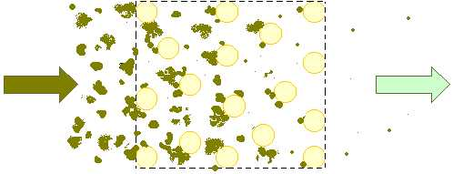
2.4 Deep filtration
Depth filter are able to capture particles that are too small to be sieved out as in flat filtration. Particles, which can be a lot of smaller than the distances between the fibers penetrate into the fiber structure. Filtered particles are captured in terms of the filtration mechanisms. This type of the filtration process is important for the most of filter applications. Next chapters about filtration variables, properties and mechanisms refer first of all to the deep filtration.
Advantages:
Longer lifetime
Better relation between pressure drop and filtr efficiency
Disadvantages:
- Usually it is not possible to clean clodged filter
Direction of flow
Textile filter expressed as a set of cylinders placed in parallel
Captured particles

Slide 8
4 Principle of filtration - relation between filtration variables and filter properties.
It´s simple to say “what is filtration” but difficult to describe relations between filter properties and the main filtration variables which influence the filtration process
Filtration properties
Efficiency
Pressure drop
Lifetime
Resistivity against surrounding conditions
Others (permeability, porosity...)
Filtration variables
Filter variables
Flowing medium variables
Captured particles variables
Filtration mechanisms
Diffusion deposition
Direct interception
Inertial deposition
Electrostatic deposition
Sieve effect

Slide 9
4.1 Filtration properties – output of the filtration process I.
Filter efficiency
It is the ratio of particles captured by a filter over the total number of particles found in the air upstream of the filter. Filter efficiency can either be based on specific particle size ranges or based on the total number of particles of all sizes.
Efficiency can be defined by formula 1, where G₁ is an amount of penetrated particles (which haven´t been captured) and G₂ is total amount of particles upstream
formula 1.
Expression G_{1/}G₂ is named „Penetration“ of filter
Efficieny is changing during the filtration process (see chapter 6.3.4 Nonstationary filtration)

Slide 10
Filtration properties – output of the filtration process II.
Pressure drop
Pressure drop indicates the restance to flow. It is defined as a difference between the pressure of flowing media upstream and downstream of the filter. For expression of pressure drop is necessary to assign air flow or air velocity (linear relation).
Δp = p₁ - p_{2,} where p₁ is pressure drop upstream and p₂ downstream of the filter. Pressure drop is changed during the filtration proces (see chapter 6.3.4 Nonstationary filtration).
Filter lifetime
Filter lifetime determines the time when the filter must be removed. It is defined as a time or as an amount of the filtered particles, which are loaded into the filter until the filter is full.
According to EN 779 standard the filter lifetime is defined as a „Dust holding capacity“:
J = E_{s}.m_{p} where E_{s} is mean filter efficiency and m_{p} is the amount of the particles loaded into the filter until the final pressure drop (250 or 400 Pa) was reached

Slide 11
Filtration properties – output of the filtration process III.
Other properties I.
Permeability
It is the ability of a material to allow the passage of a liquid or gas through porous material. It is possible to find more defininitions, whic depend on the level of simplification:
1) According to EDANA 140.1 standard it is defined by formula:
where M_{s} is permeability (l/dm²/min), Q is the flow (l/min)and A is the filter surface. Permeability is tested with the pressure drop 196 Pa (98,1 Pa for some standards)
2) According to the Darcy´s law the permeability is defined by formula:
where K is permeability (m/Pa/sec) and Δp is the pressure drop (Pa).
3) According to the Darcy,s law is possible to define permeability as a „permeability coefficient“ defined by formula:
where k₁ is the permeability coefficient (m²), η is the dynamic viskosity (Pa.sec), and h (m) is the thickness of the filter.

Slide 12
4. According Hagen-Dupuit-D´Arcy´s model is permeability defined as:
where K₃ is permeability coefficient and C is form coefficient.
This model is suitable for higher flow of viscose liquid (such as water etc…). When we compare HDD model with D´Arcy´s law, the main difference is nonlinear relation between flow and pressure drop.
Permeabilityof laminated textiles
For simple D´Arcy´s law it is possible to deduce relation between the permeability of one layer and more layers. For most of the applications we can assume that the flow through the laminated textile is the some as flow through one layer. Than the total pressure drop and total permeability are defined:
and ,
where Δp_{i} and K_{1i} are pressure drop and peremability coefficients of each layers

Slide 13
Filtration properties – output of the filtration process IV.
Other properties II.
Porosity and pore size
Porosity of porous medium is defined as a percentage of the porous material volume not occupied by fibers.
Very important is size or size distribution of pores, which depends on the pore definition and on the used test method.
Testing methods:
Image analysis of 2D microscopic wiew – direct method
Sifting of defined particles through the textile
Penetration of liquid agent into the textile – relation between pore size and surface tension of liquid.
a) Wetting agent is pushed away from textile due to pressured gas – Bubble point method
b) Non-wetting agent is pushed into the textile – Mercury porosimetry
For more informations see subject „High functional textiles“.

Slide 14
Description of simple Bubble point method:
We assume circular pores. Wetting liquid (wetting angle = 0) try to go through the pores due to wetting force F_{γ}= π.D. γ. Against this force we can act by pressured gas (F_{p} = p.A_{pore}). D is pore diameter, γ is liquid surface tension, p is gas pressure and A_{pore} is pore cross section surface. When the first bubble of gas is going through the pore – both forces are in equilibrium.
At first bubbles are going through the maximum pore. When we can measure flow rate of gas is possible to measure the distribution of pore sizes.
F_{γ} = γ . π . D
bubble
Wetting agent
D
textile
F_{p} = p . A_{pore}

Slide 15
4.2 Statinary and nonstacionary filtration
It is important that the filtration properties are changing during the filtration process. A captured particle, since it occupies a finite space, becomes part of the filter structure, able to contribute both to pressure drop and to filtration efficiency. When we neglect this assumption the filtration process is named „stationary“. It is possible in the beginning of the filtration process. When we assume that the deposited particle influences filter properties the filtration process is named „nonstationary“ [Pich, 1964]. Secondary proceses of nonstationary filtration are:
Filter clogging – particles fill the filter structure
increase of pressure drop
increase of filter efficiency
Particle disengagement
decrease of filter efficiency
Capillary phenomena
flushing of drops
formation of fluid layers in placed where the fibers are spiced
condensation of water
Loss of electric charge
decrease of filter efficiency
Filter destruction

Slide 16
4.3 Test method of filtration properties:
Tested properties are efficiency, fractional efficiency, pressure drop, pressure drop vs. air flow, filter lifetime etc... Properties are tested as initial or during filtration process. Methods are differ in the particle substance (electrical properties, adhesion etc...), particle size (coarse/fine), particle size range (monodisperse, polydisperse), particle concentration etc...
1) Synthetic dust
The dust is blend prepared from melted anorganic (and organic) particles. The most known is ASHRAE dust that has the some parameters as the dust around Arizona roads [ASHRAE 52,2, 1999]. It is used for coarse filters (particles are coarse and polydisperse). It is possible to test change of properties during the filtration process and filter lifetime. Dust is measured by weighting method. This method is very popular and easy to use. However, it is open to criticism because weight measurements give predominantly the weight of the largest particles in the sample. Used standards are: EN 779 [EN 779, 200], ASHRAE 52,2 etc...
2) Athmospheric dust spot efficiency
In the Atmospheric Dust Spot Efficiency ambient outdoor atmospheric air is passed through the unit being tested and samples are taken at the inlet and outlet of the unit to evaluate its collection efficiency on the dust particles suspended in the atmosphere. This test is replaced with DEHS aerosol method because athmosperic air composition is changing. Used standard was older version of EN 779 [Gustavsson, 1999] .

Slide 17
3) Oil aerosols (DEHS, DOP, paraffin oil)
As the test matter is used aerosol from liquid oily substances. The most known are: dioctylphtalate (DOP), diethylhexylsebacate (DEHS) and paraffin oil. Two types of oil aerosol are known: Cold and hot. If the oil is dispersed and dryed in cold ambient conditions (Laskin nozzle) then the size range of particles is wider (polydiperse aerosol). If the oil is dispersed and dryed in hot ambient conditions then is possible to obtain monodisperse particles (0,1-0,3 μm). Particles are analyzed by laser particle counter or by spectrofotometric method. It is possible to detect efficiency of selected particle size (except paraffin oil). Particles are insenzitive to electrostatic field. Initial values of This method is used for fine and high efficient filters – HEPA (high efficiency particulate air filter) and ULPA (ultra low penetration air filter) filters.
4) NaCl aerosol
Sodium Chloride aquelous solution is dispersed and dryed. These polydisperse particles have mean size 0, 65 μm and their penetration through the filter is analysed by spectrofotometer. This method is suitable for quick test of high efficient filters (respirators especially). Used standards are: BS 4400 [BS 4400, 1969], EN 143 [EN 143, 2000], etc...
5) Methylen blue test
The solution of methylen blue is dispersed and dryed. Particles are analysed by comparing of the blue colour intensity upstream and downstream the filter. It is suitable to high efficient filters. By reason of narow gauge usage is replaced by sodium chloride aerosol test.

Slide 18
Summary of test methods:

Slide 19
4.4 Types of filters based on filter efficiency:
Filters are classified according to international standards:
a) European standards EN 1822 (1998) and EN 779 (2002):

Slide 20
Applications of filters according to EN 779 and EN 1822 standards.

Slide 21
b) American standard ASHRAE 52.2 (1999)
Coarse filters (MERV 1 – 4) are tested by synthetic dust, other filters are tested by pottasium chloride particles with defined size (0,3 - 10 μm) divided onto three ranges.

Slide 22
Applications of filters according to ASHRAE 52.2 standard.

Slide 23
3. Types of filters based on its shape:

Slide 24
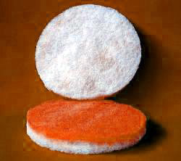
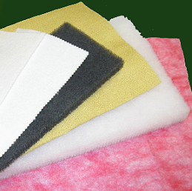
A) Flat filters:
Description and examples:
Flat filters are used without frame or (for bigger size) holded by rigid frame or supporting grid. They would be divided onto two variants. Bulk filters are: thermal or chemical bonded nonwovens, needle punch etc... Thin filters are:woven and knitted fabrics, spunbond, meltblown etc....
End use:
Cheap filters for common applications (vacuum cleaners, kitchen digestor, paint boxes, cabine filters in cars...) , pre-filters for most of air ventilation systems.
Filter
Supporting grid
Polluted air
Clean air
a) bulk filter
b) thin filter

Slide 25
B) Pleated filters
Description :
It is suitable fo high efficient filters. Pleating process leads to bigger filter surface and consequently to smaller pressure drop. It is possible to pleat flat materials, which stiffness and elongation is similar to paper (for example wet-laid nonvoven from glassfibers). It is necessary to hold textile pleats by rigid frame. Filter thickness is usually from 1 to 5 cm.
End use:
Pre-filters, HEPA filters (High Efficiency Particulate Arrestance) used in air ventilation and air condition systems, Auto cabin air filters, industrial applications, respirators for halfmasks etc...
Polluted air
Rigid frame
Air flow direction
Filter thickness
Clean air
Filter

Slide 26
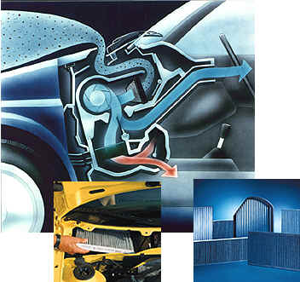
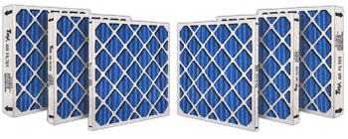
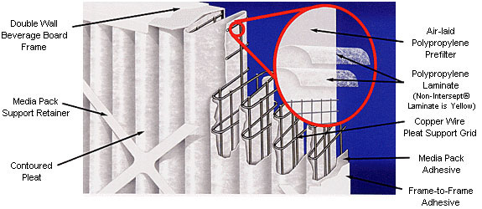
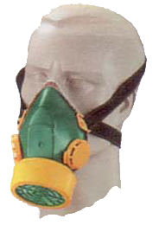
Examples of pleated filters:

Slide 27
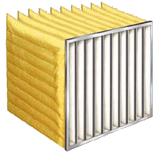
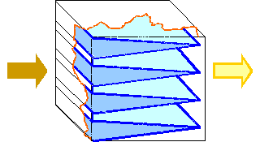
C) Pocket filters
Description and examples:
Principle is similar to pleated filters, only filter thickness is similar to other filter dimensions. Generally it is possible to use nearly all textile fabrics („paper properties“ are not necessary). At first are stitched or bonded each pockets and then it is embed onto the frame. Big dimension of this filter would be disadvantage.
End use:
Pre-filters for pleated HEPA filters or final filters for less superior industrial applications.
Polluted air
Filter
Clean air

Slide 28
D) Cartridge filters
Description and examples:
Flat (bulky) filter or pleated filter is wrapped around the perfored tube. The advantage is smaler dimension of filter with regard to acting surface.
End use:
Most of filters inside the car, industrial applications etc... Very ofter used for liquid filtration.
Clean air
Variants of cartridge filter cross-section
Polluted air
Filter
Flat (bulky) filter
Pleated filter
Perforated tube
Container

Slide 29
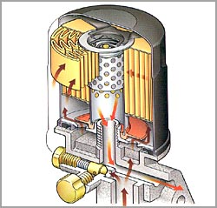
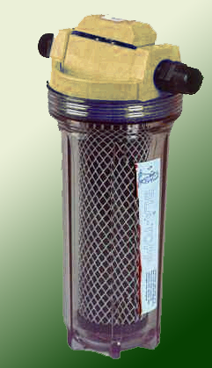
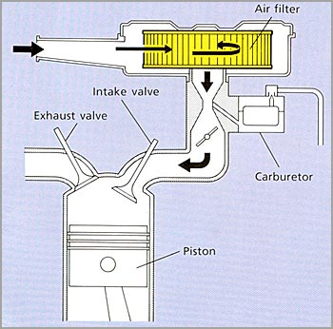
Examples of cartridge filters

Slide 30
E) Bag filters, pulse-jet filters
Description and examples:
Principle is similar as cartridge filters however bag length is much bigger than diameter and usually filter is cleanable by reverse pressure pulse. Commonly many bag filters are used for one application (hundreds). Most of the dust is collected on the surface of filters. When the increasing pressure drop reached a set value, the filters are cleaned by a short burst of compressed air moving in reverse direction. Typical maximum pressure drop is 1000 – 2000 Pa, typical pressure pulse is in range 0,5 – 1 MPa and cleanig time 0,1 - 100 sec.
End use:
Industrial applications: chemical processings, cement fabric, incineration, power generation etc...
Filters
Outlet of clean air
Inlet of polluted air
Output of captured particles
Back pulse of pressed air

Slide 31
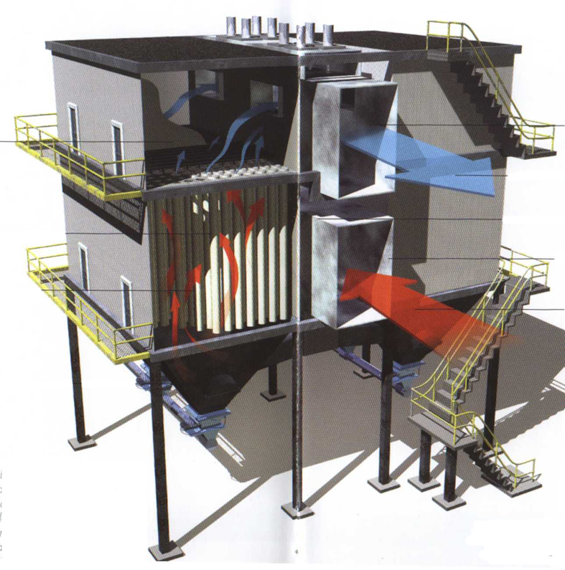
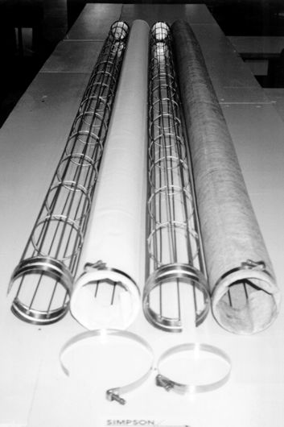
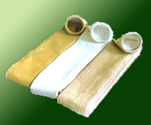
Examples of pulse-jet filters
Steel frames

Slide 32
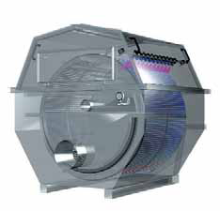
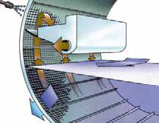
Drum filters
1.The rotating drum is actually a frame with
mounted filter panels. The filter panels use a
polyester or stainless steel filter cloth that is
of a specific micron porosity.
2. Waterborne solid waste particles enter the
Drum Filter from the inside of the rotating drum.
3. Solid waste particles (larger than the micron
porosity rating of the filter screens) are
ocaptured n the filter screens.
Water passes through the filter screens.
5. A float level switch or timer initiates filter screen rinse.
6. The screen is rinsed and solid waste particles wash down into the waste
trough where they collect and exit the filter.

Slide 33
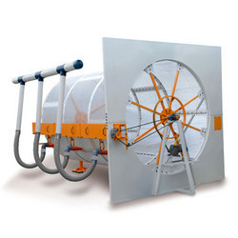
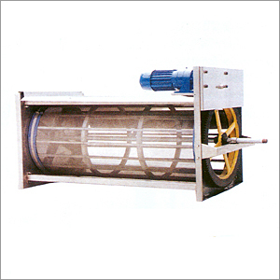
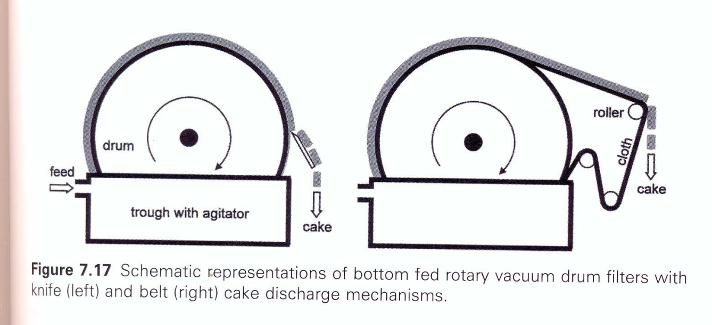

Slide 34
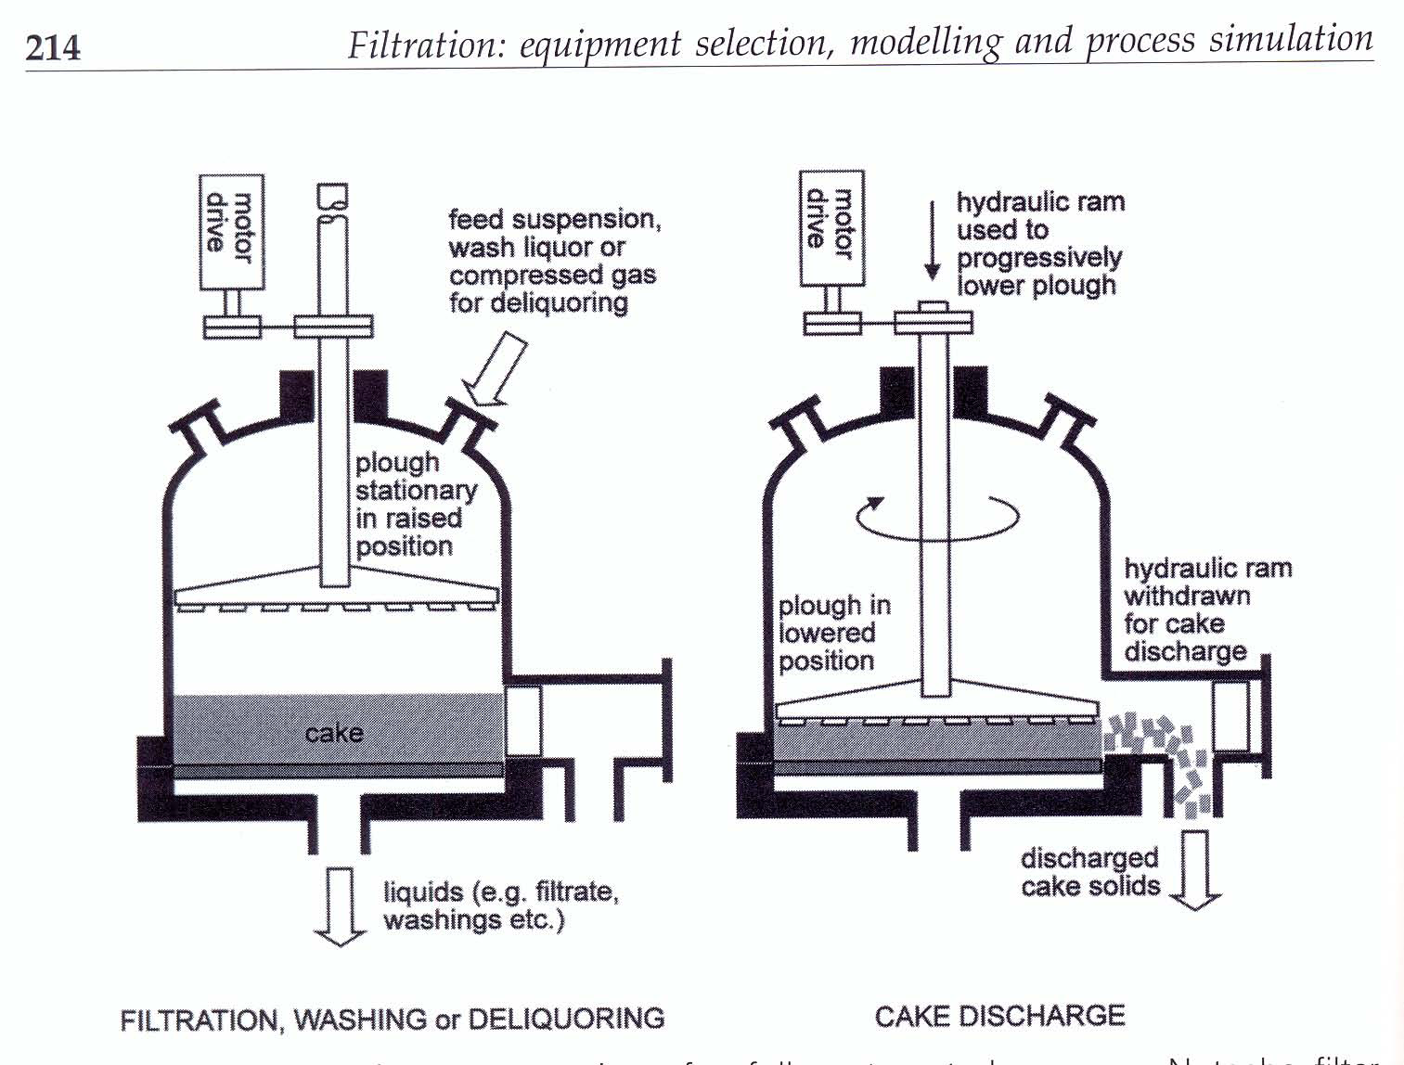
Disc filters:

Slide 35
